Slide 1
JA Finance Park
JA Finance Park will help you build a foundation for making intelligent, lifelong personal financial decisions. Topics include income and saving, credit and debit, and budgeting.
© 2024 Junior Achievement USA, M1205 – Debit and Credit PowerPoint
JA Finance Park®
Notes:
JA Finance Park Debit and Credit

Slide 2
Debit and Credit
Compare financial institutions, and weigh the advantages and disadvantages of credit and debit.
1
Notes:
JA Finance Park Debit and Credit

Slide 3
Banking Partners Vocabulary
bank: a for-profit institution that offers personal loans, mortgages, and other services
credit union: a not-for-profit cooperative that offers bank services and is owned by its members
financial institution: a business that provides money-related services
Notes:
JA Finance Park Debit and Credit

Slide 4
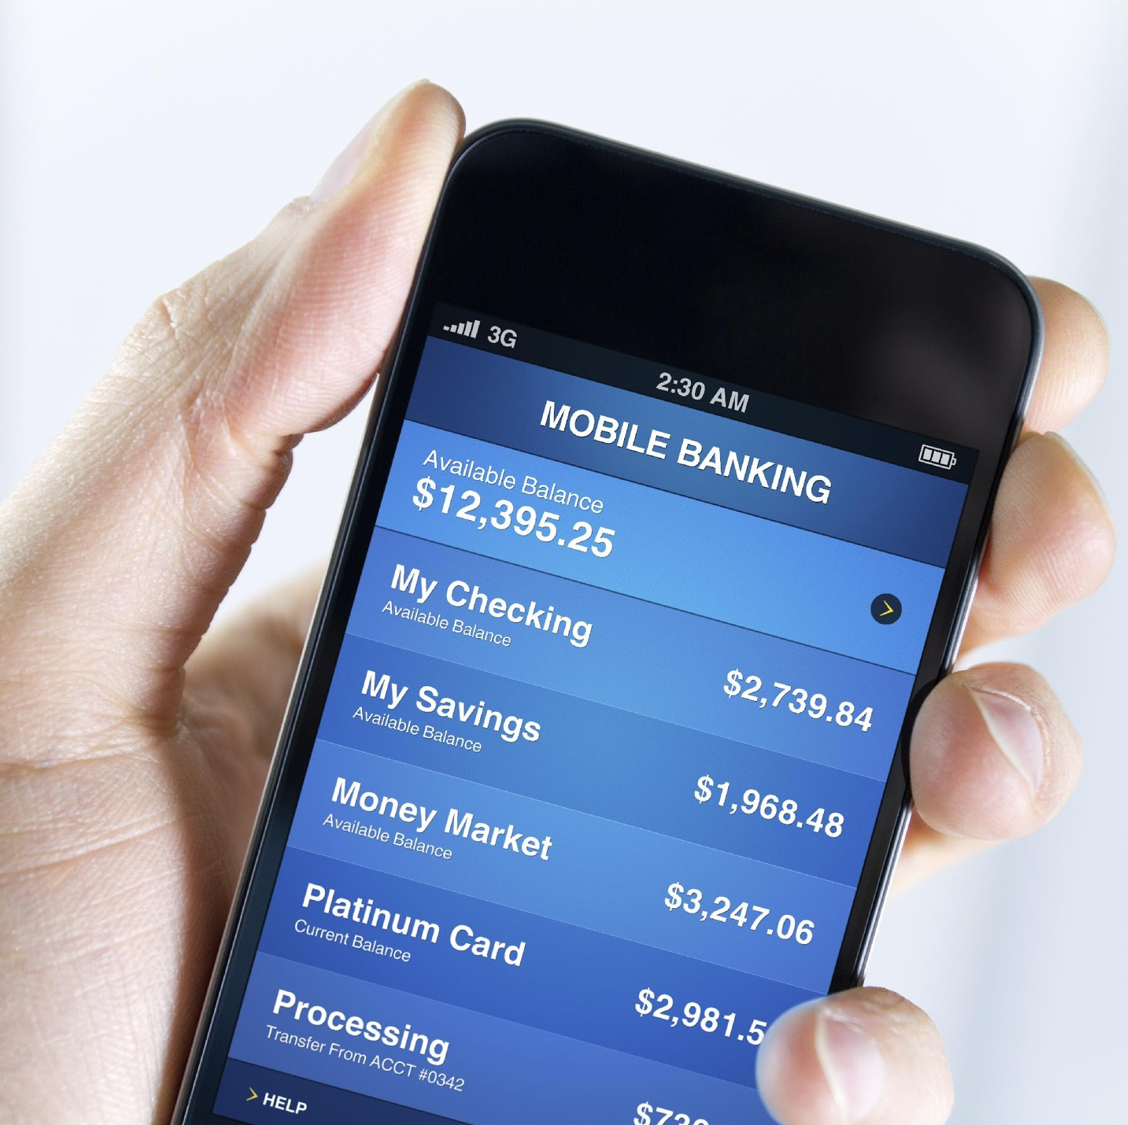
Banking Partners Vocabulary continued
interest: a fee received or paid for the use of money
Internet bank: a Web-only bank
mobile banking: a wireless service that allows financial transactions by using an app or Web browser from a mobile device
online banking: an electronic way to view account activity and pay bills via the Internet and an institution’s website
Notes:
JA Finance Park Debit and Credit

Slide 5
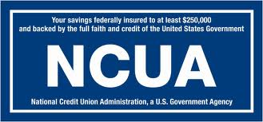
Bank and Credit Union
Bank
For-profit institution
Mortgages and debit and credit cards
FDIC insured (up to $250,000)
Credit Union
Not-for-profit institution
Mortgages and debit and credit cards
NCUSIF insured (up to $250,000)
Member owned
Notes:
JA Finance Park Debit and Credit

Slide 6
Online and Mobile Banking
Bank via the Internet.
Log on securely to an account or app using a username and password.
Manage accounts and pay bills online.
Deposit checks into eligible accounts with the camera on a mobile device.
Safety Alert Tip! The Internet is a public network; safeguard your banking information.
Notes:
JA Finance Park Debit and Credit

Slide 7
Internet Bank
An online bank; no physical branches with tellers or drive-up windows.
Customers access money via the mail, mobile apps, telephone, Web page, and ATMs.
Name and password are needed to securely log on to an account.
Safety Alert Tip! Check your bank’s website for its security measures.
Notes:
JA Finance Park Debit and Credit

Slide 8
Personal Spending Vocabulary
cash: money in the form of bills or coins
check: a written order for a bank to pay money
credit card: a card authorizing the holder to buy goods and services that can be paid for later
debit card: a card that looks like a credit card but operates like cash; money is immediately subtracted from the cardholder’s bank account when a purchase is made
Notes:
JA Finance Park Debit and Credit

Slide 9
Debit Cards
Advantages of a Debit Card
Buy now, pay now.
Operates like a check or cash.
No interest charges.
Withdraw cash at ATMs using the card’s PIN (personal identification number).
No annual fee (usually).
Federal law limits liability to $0 if the card is reported missing before someone uses it.
Disadvantages of a Debit Card
Monthly maintenance and overdraft fees may apply.
ATM charges for out-of-network banks.
Debit card use is not a way to build credit history; activity is not reported to credit bureaus.
There’s a $500 liability if the card is reported missing more than two business days after a loss or theft, but less than 60 calendar days after a statement is sent.
Notes:
JA Finance Park Debit and Credit

Slide 10
Credit Cards
Advantages of a Credit Card
Buy now, pay later.
Flexibility to make purchases anytime and anywhere.
Grace period is usually 25 days.
$50 liability if card is stolen.
Disadvantages of a Credit Card
Must qualify.
Terms and fees may change.
High interest rates usually apply on unpaid balances.
Notes:
JA Finance Park Debit and Credit

Slide 11
Sample Credit Card Statement
Notes:
JA Finance Park Debit and Credit

Slide 12
Cost of Using Credit
Making minimum payments, with no new purchases, at an interest rate of 18%
Purchase Price of Goods | Minimum Monthly Payment | Time to Pay Off Debt | Interest Paid | True Cost
$1,000 | $20 | 8 years | $863 | $1,863
$2,500 | $50 | 23 years | $5,363 | $7,863
$5,000 | $100 | 35 years | $12,863 | $17,863
Notes:
JA Finance Park Debit and Credit

Slide 13
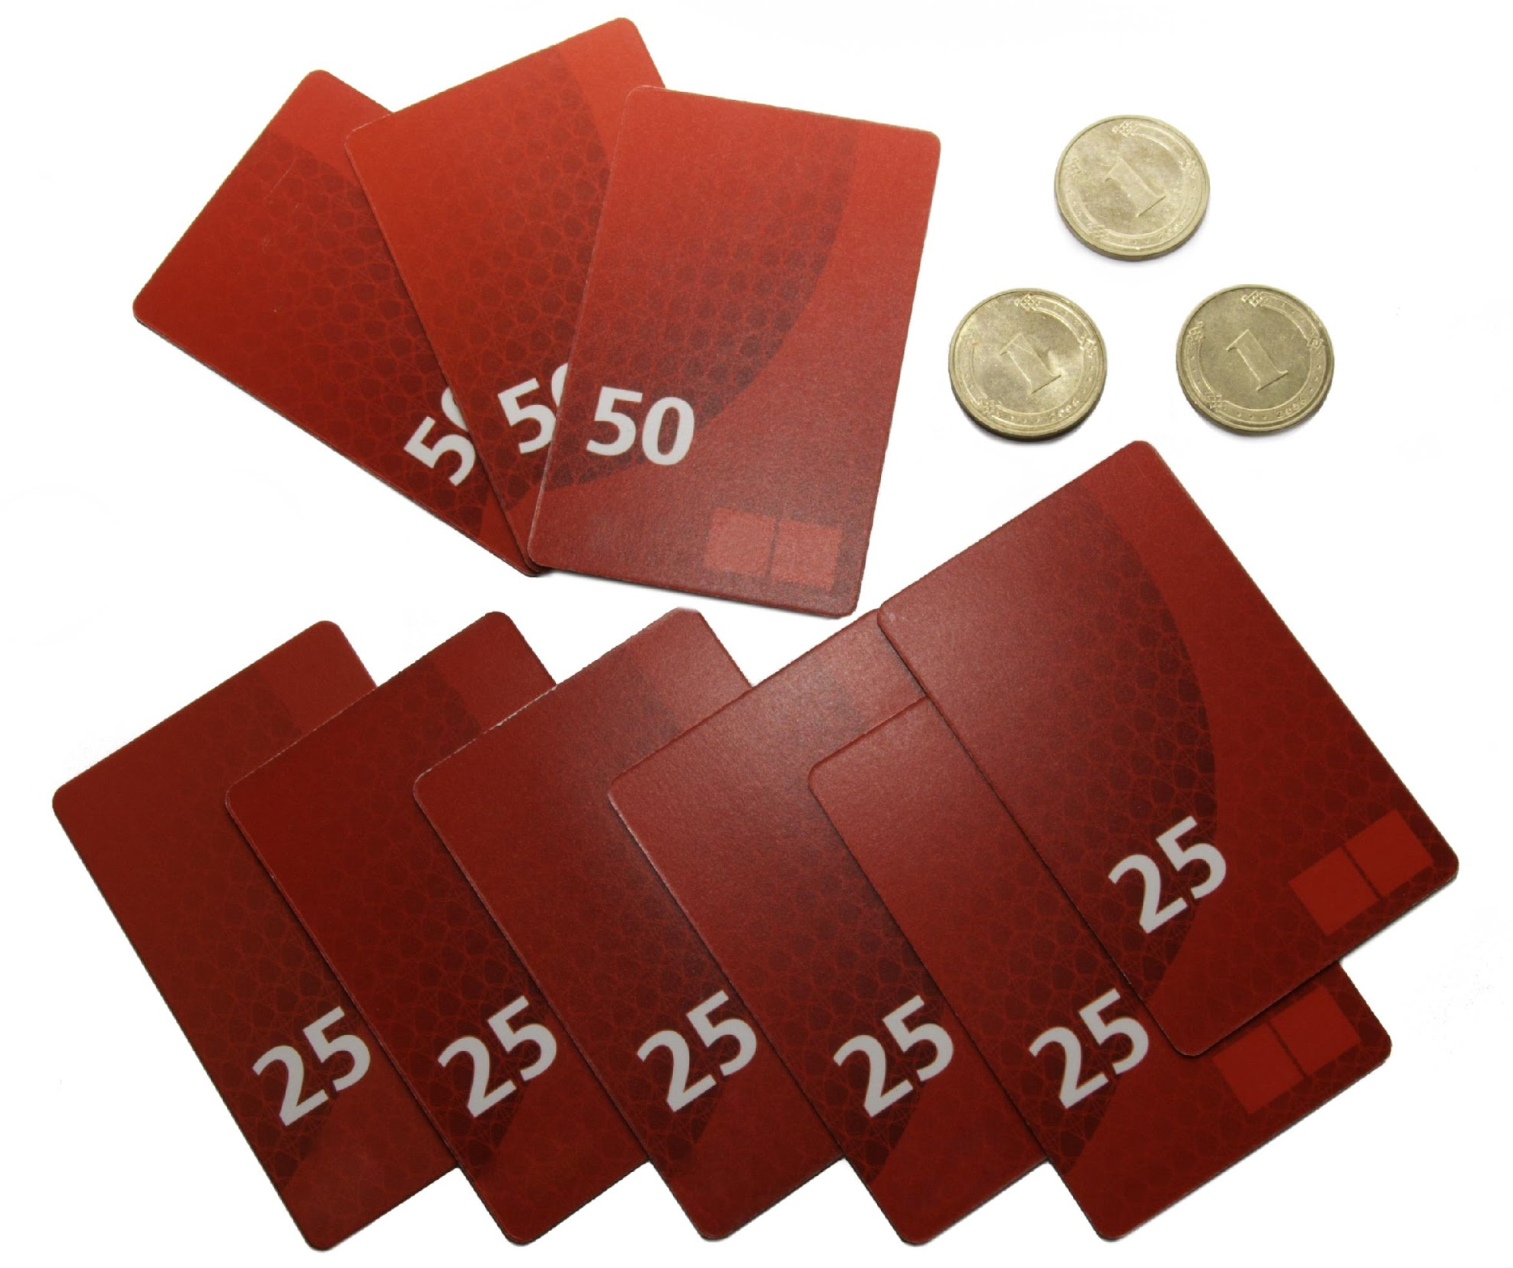
Prepaid Cards
Also known as prepaid debit, stored value, or gift cards. May require activation. Spending is limited to the card amount.
Do not need a bank account or a credit history.
For some card types: Manage cash reloads and account information online.
Prepaid payroll card: Employers deposit wages directly to the card.
Notes:
JA Finance Park Debit and Credit

Slide 14
Bankruptcy and Foreclosure
If a loan holder cannot repay his or her debt, then bankruptcy protection may be imposed by a court. According to the Federal Trade Commission (FTC), consumers must get credit counseling from a government-approved organization and complete a debtor education course before debts are cleared.
Consumers who are having trouble paying their home mortgage on time may face foreclosure. Foreclosure is a court process and involves a lawsuit in which a bank or mortgage company seeks to take an owner’s property to satisfy a debt.
Notes:
JA Finance Park Debit and Credit

Slide 15
Savvy Shopper Board Game
The SAVVY SHOPPER game will help you see the costs and benefits of debit and credit cards.
GOAL: Be the first player to buy food, jeans, headphones, shoes, and concert tickets and have $0 debt.
Notes:
JA Finance Park Debit and Credit

Slide 16
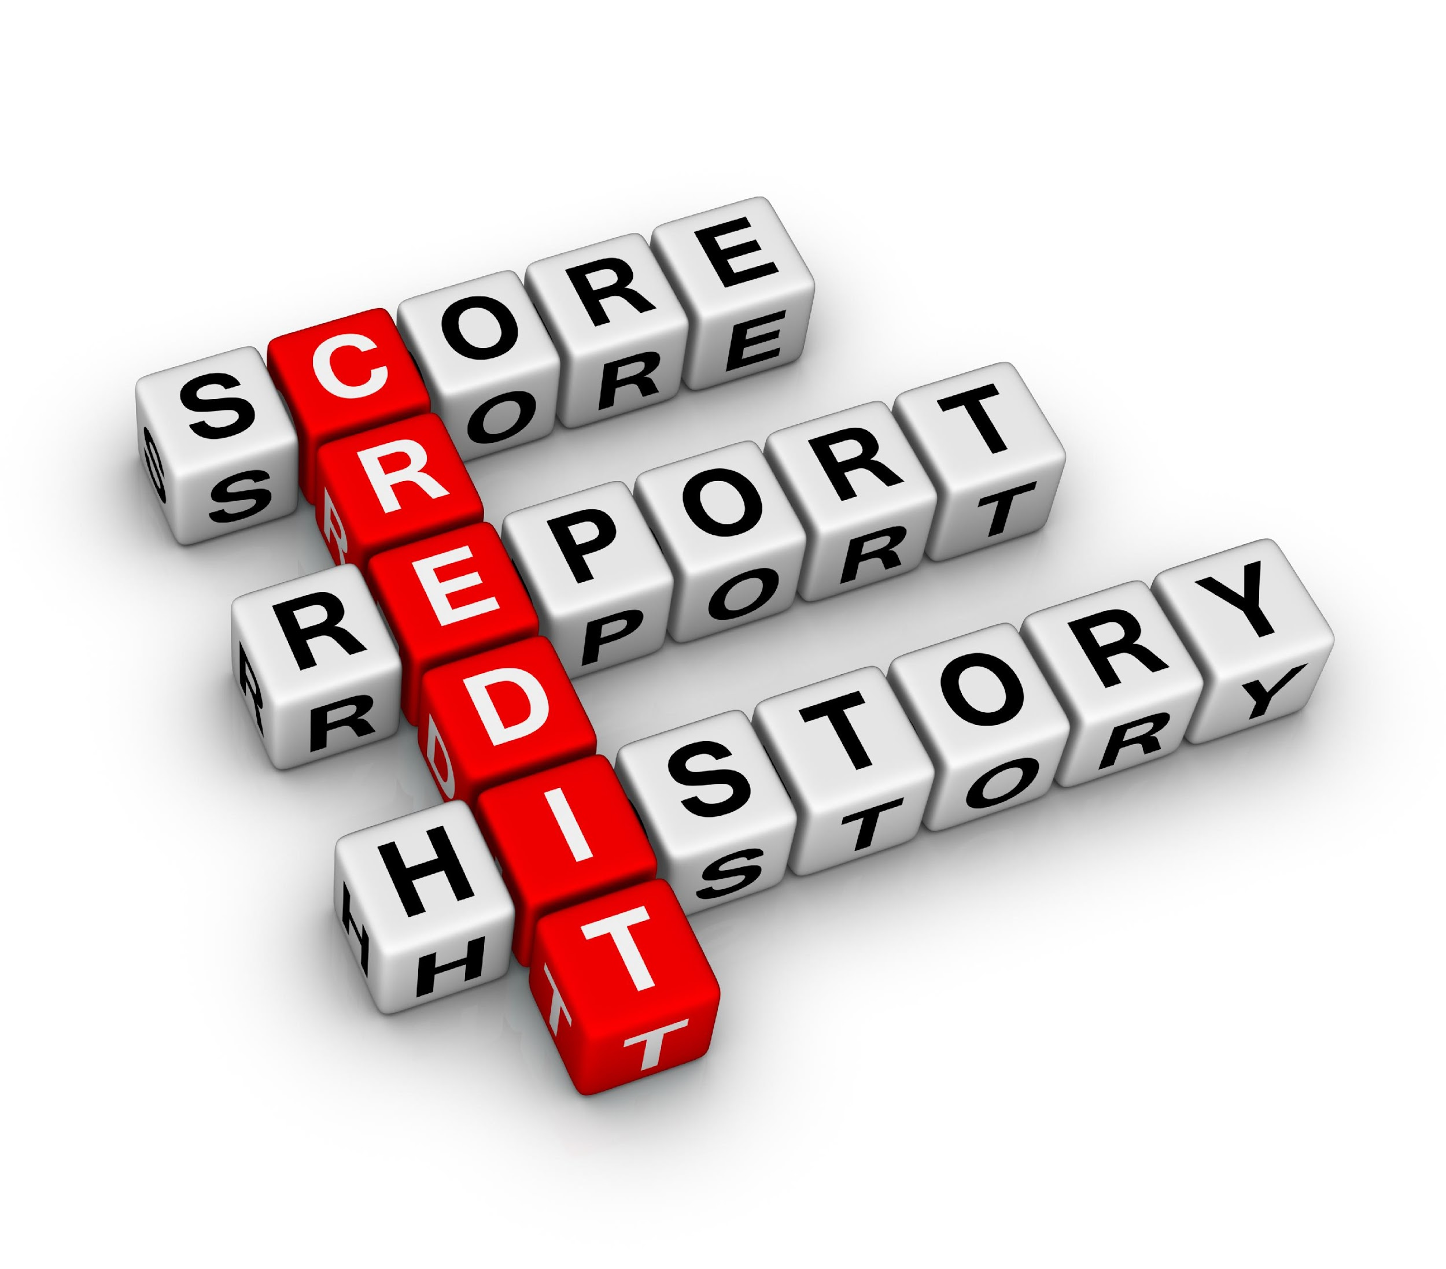
Managing Credit Vocabulary
credit report: a record of a person’s financial information, including previous addresses, Social Security number, current and previous employers, estimated income, credit card accounts with amount owed and payment history, and loan information
credit score: a standardized measurement of the potential to repay a debt
Notes:
JA Finance Park Debit and Credit

Slide 17
Are You a Good Credit Risk?
Do you pay your bills on time? Do you miss payments?
How many credit accounts do you have?
Have you paid off a loan before?
Are you maxed out? Are you near your credit limit?
Do you have outstanding debt? How much?
Notes:
JA Finance Park Debit and Credit

Slide 18
Credit Dings
Making late payments.
Exceeding your credit limit.
Applying for credit frequently.
Having an account turned over to a collection agency.
Notes:
JA Finance Park Debit and Credit

Slide 19
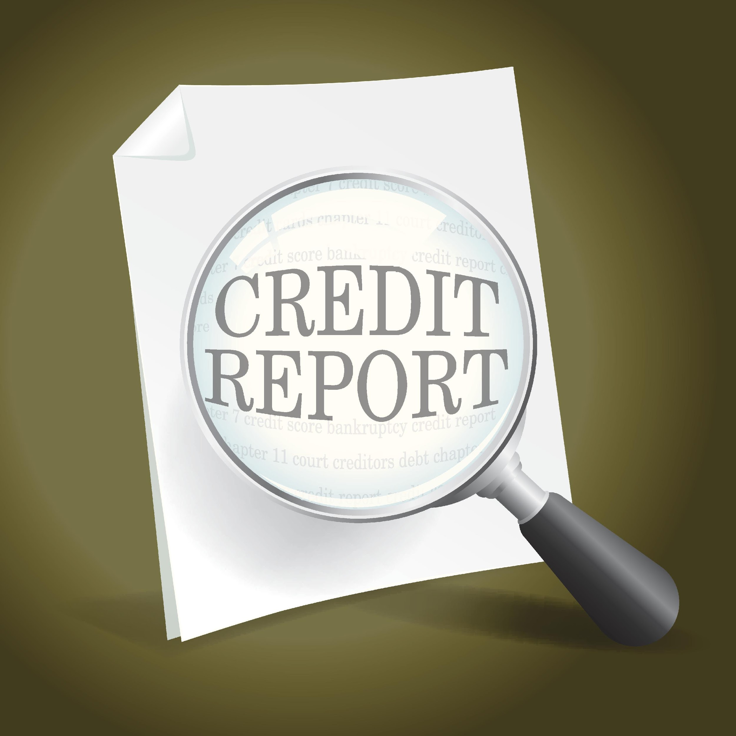
Credit Report Agencies
EQUIFAX, EXPERIAN, and TRANSUNION must provide consumers with a free copy of their credit report, upon request, once every 12 months by law.
Notes:
JA Finance Park Debit and Credit

Slide 20
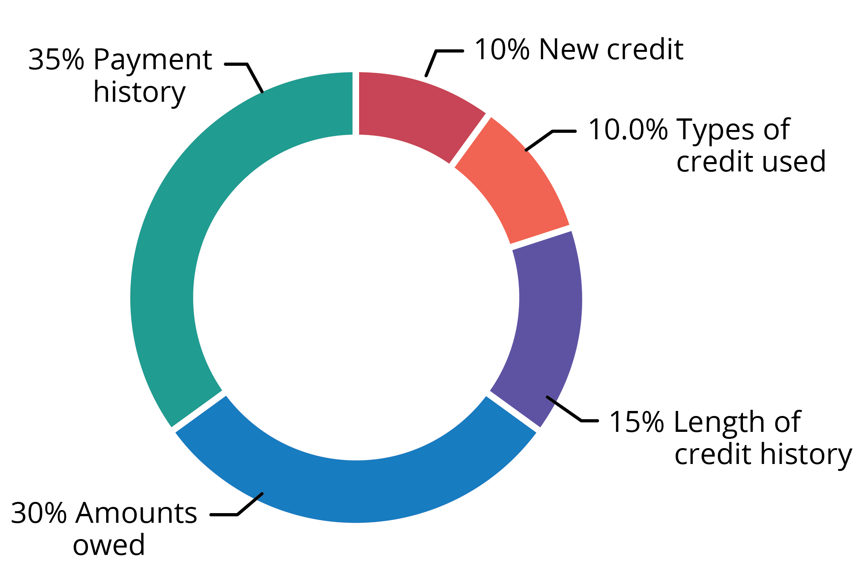
FICO Score Breakdown
A FICO score considers five categories of credit data.
Source: www.myfico.com
Notes:
JA Finance Park Debit and Credit

Slide 21
FICO* Credit Score
Credit Type | Score Range
Very Good to Exceptional | 740–850
Good | 670–739
Fair | 580–669
Poor | 300–579
*FICO is an acronym for the Fair Isaac Corporation, founded in 1956 by engineer Bill Fair and mathematician Earl Isaac. Together, they developed the formula for the FICO score, the credit risk measurement that is used most around the world.
Source: https://www.experian.com/blogs/ask-experian/credit-education/score-basics/what-is-a-good-credit-score/
Notes:
JA Finance Park Debit and Credit

Slide 22
Build a Positive Credit History!
Choose a credit card carefully.
Look for no annual fees / low interest rate.
Use credit to build a payment history.
Don’t charge more than you can pay.
Pay your bills on time—don’t skip payments.
Notes:
JA Finance Park Debit and Credit

